Slide 1
Raster to Vector conversions in the case of uncertainty
Cristobal Guerrero
James Schaffer
Department of Electrical and Computer Engineering, Summer 2012

Slide 2
Recap
Code was rewritten with methods so that it would be more readable.
Began to modify/finish the implementation of a previously described uncertain vector model.

Slide 3
First method
Our first iteration converts a raster to a vector based upon the pixels color intensity as the distance from the core was increased
This approach works fine in the crisp case, but does account for uncertainty in the data.
We need to be able to sample a point (x,y) in our model to sample a corresponding probability value - similar to the way we can sample the raster.

Slide 4
Future Implementation
From our new uncertain model, probability will be calculated when choosing points at random within the segmented region.
The probability of the uncertain region will be based upon distance from the core to the edge of the outer region, and an underlying probability distribution.

Slide 5
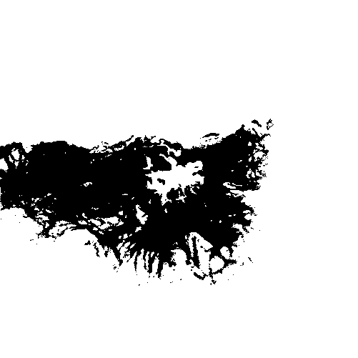
Example
f( x,y in core ) = 1
0 < f( x,y in support ) < 1
f( x,y outside object ) = 0
Need to insure that the
CDF of this
multidimensional PDF
sums to 1.0.

Slide 6
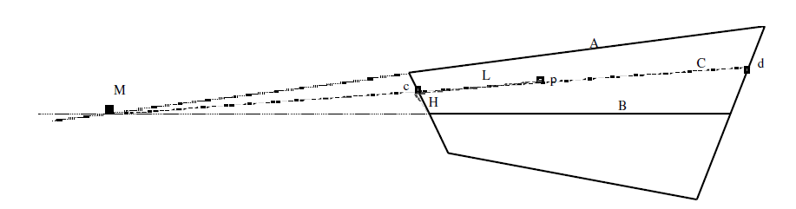
Example cont.
1. Take the lines A and B (the central line) and compute the point M in which they intersect
2. Compute the line C from M to p.
3. Compute the point c or d where the line C crosses the CrossCurves.
4. Compute the distance H between the point c and the central curve B along the CrossCurve.
5. Find how long H is compared to the CrossCurve. This ratio determines the value of the probability distribution function for point p.

Slide 7
References
1. Erlend Tøssebro, & Mads Nygård (2003). A Medium Complexity Discrete Model for Uncertain Spatial Data, 1-9.

